Slide 1
Progress Report
02-07-2020

Slide 2
Last week’s goals
Apply version control (Github) and compile documentations ✅
Error Analysis: Finding positive correlation between the streamline/node skips and the reconstructed field’s error values ✅
Implement graph based representation framework
Finding neighboring segments algorithm

Slide 3
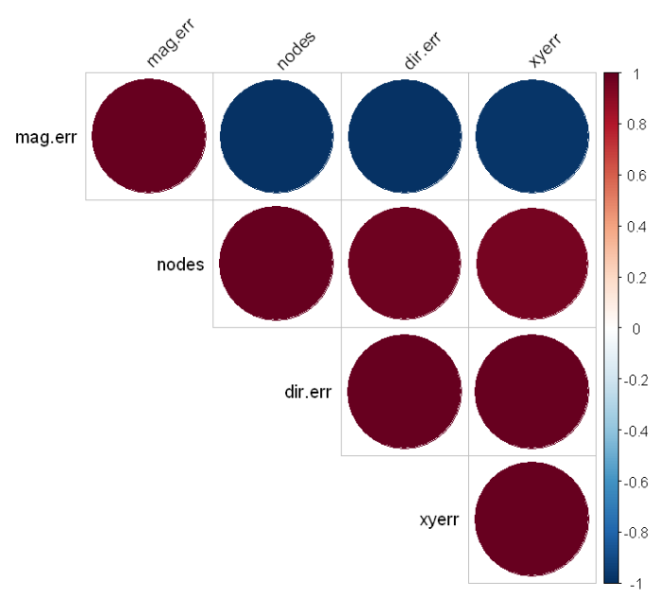
Error Analysis: Confirming positive correlation
Corrected correlation matrix by using subsets of the error values by a single streamline skip, or node skip, rather than using the entire error table.
Problem: magnitude error shows a clear inverted relation to skip values.
Todo: Use real-life 2d vector field by slicing a 3D vector field of a real life dataset.
Correl matrix where streamline_skip = 1,
Mainly shows the correlation between node skip and
Error values

Slide 4
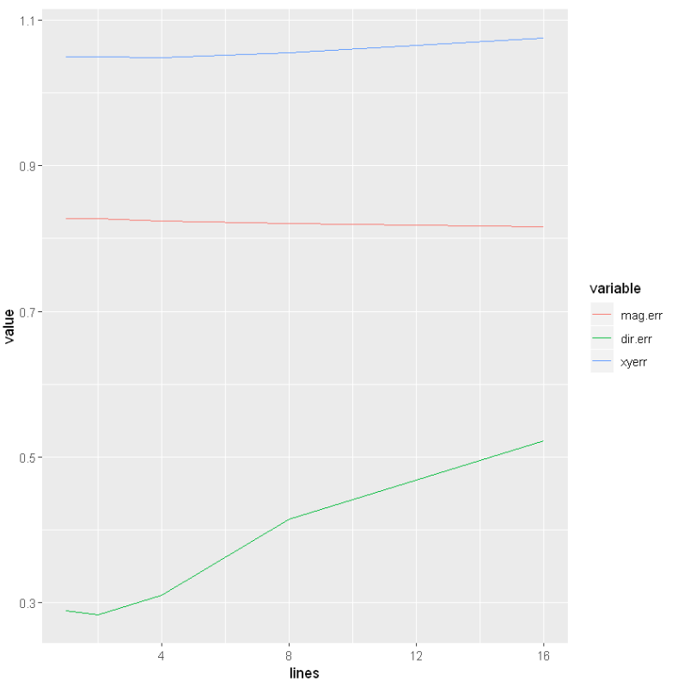
Error Analysis: Confirming positive correlation
Line plot of the change in error values based on streamline skips

Slide 5
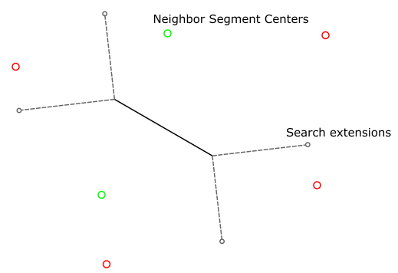
Implementation of Finding neighboring segments algorithm
Main Goal:
Locating search extensions in an efficient way
Solve linear inequalities
Filter closest segment center from result

Slide 6
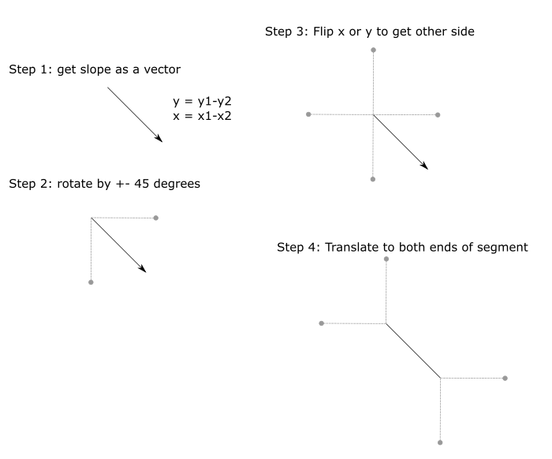

Slide 7
